Slide 1


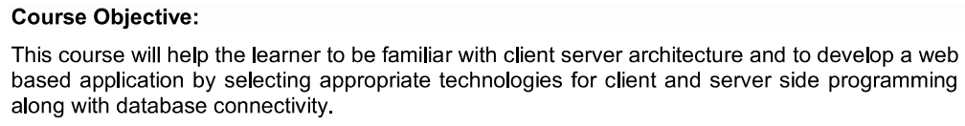
INT316 – Modern Web Applications

Slide 2
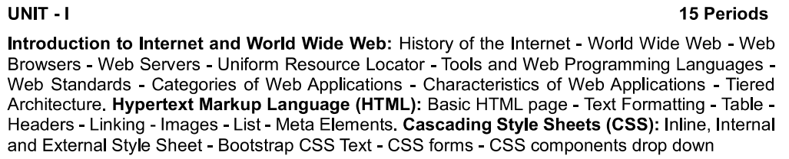
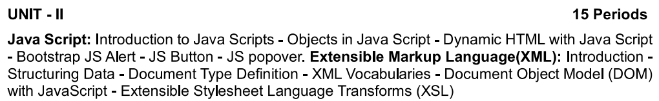
Syllabus Overview

Slide 3
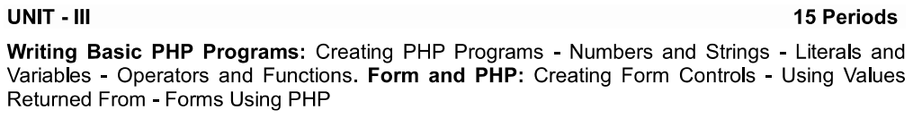
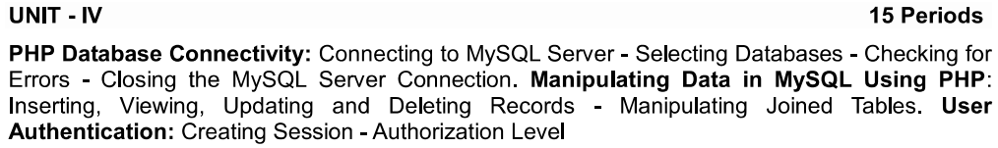
Syllabus Overview

Slide 4
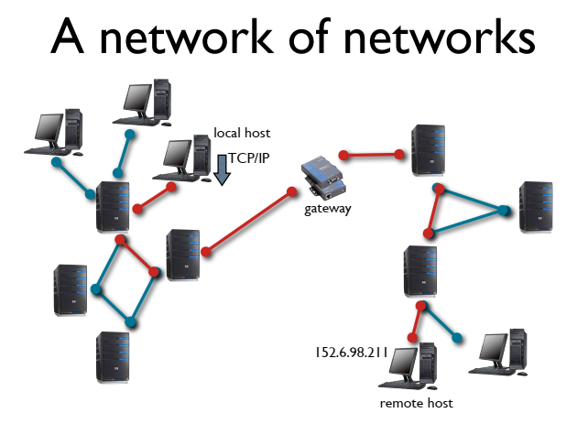
Introduction to Internet
Computer network (network of networks)
Machines and networks using different technologies
TCP/IP as communication protocol
Hosts • Any computer connected to Internet • Capable of executing user final tasks • 2 points of view - locale: executes user programs - remote: provides services

Slide 5
Network
Most people work in a network environment
A network is a collection of computers connected together with special hardware and software to manage it.
Types of Network (based on distance)
LAN : local area network (small area)
WAN : wide area network (long distances)

Slide 6
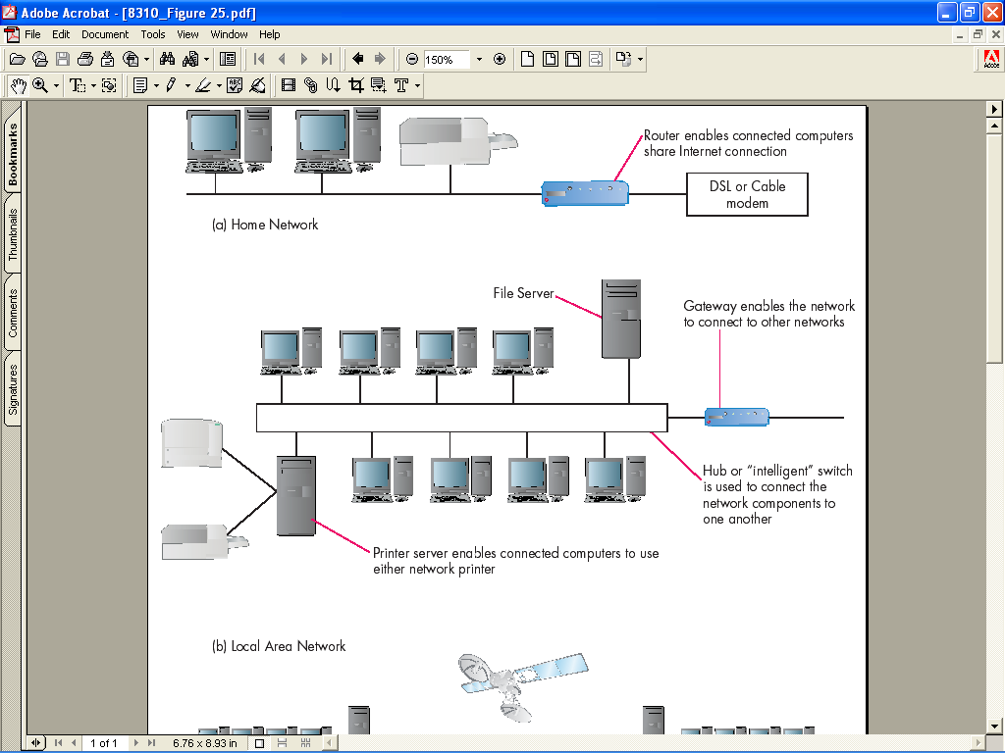
From LAN to WAN
(a) Home Network
(b) Local Area Network
Notes:
The home network and shared Internet connection has increasing relevance in today’s environment.

Slide 7
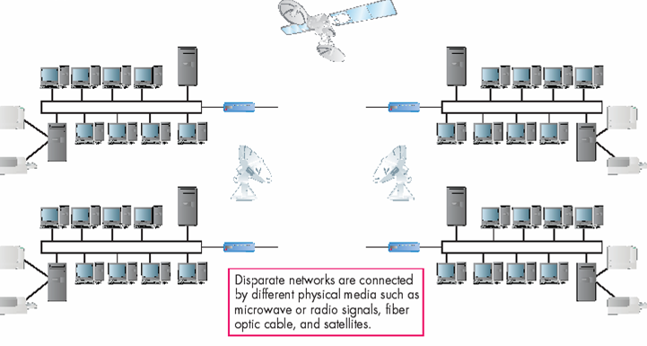
From LAN to WAN
(c) Wide Area Network

Slide 8
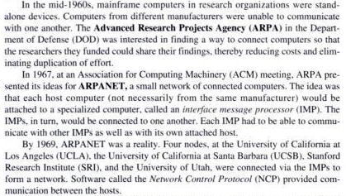
A Brief History

Slide 9
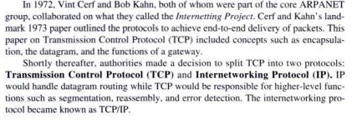
A Brief History

Slide 10
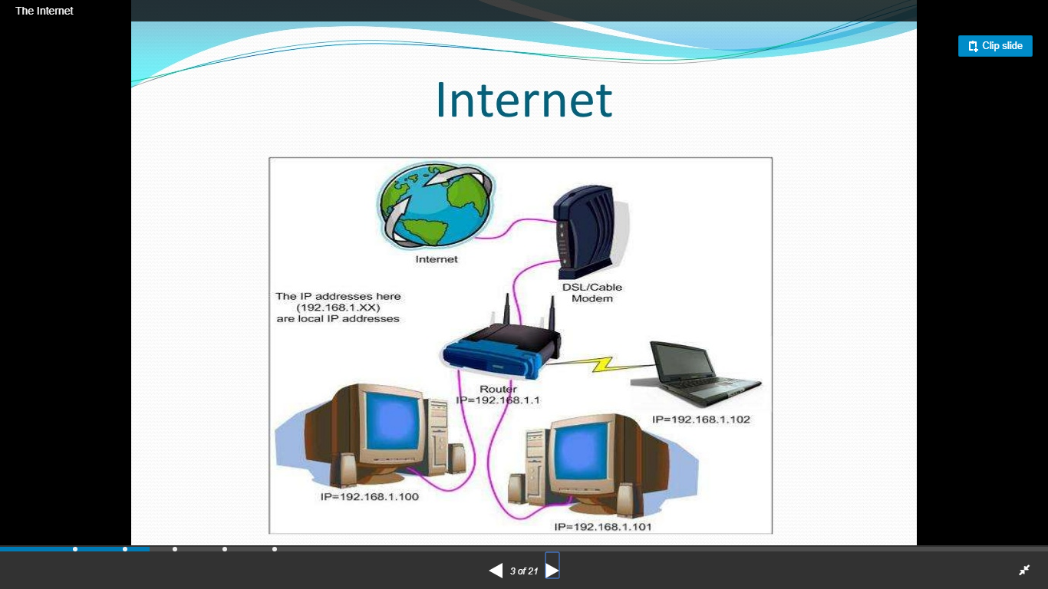
Internet today

Slide 11
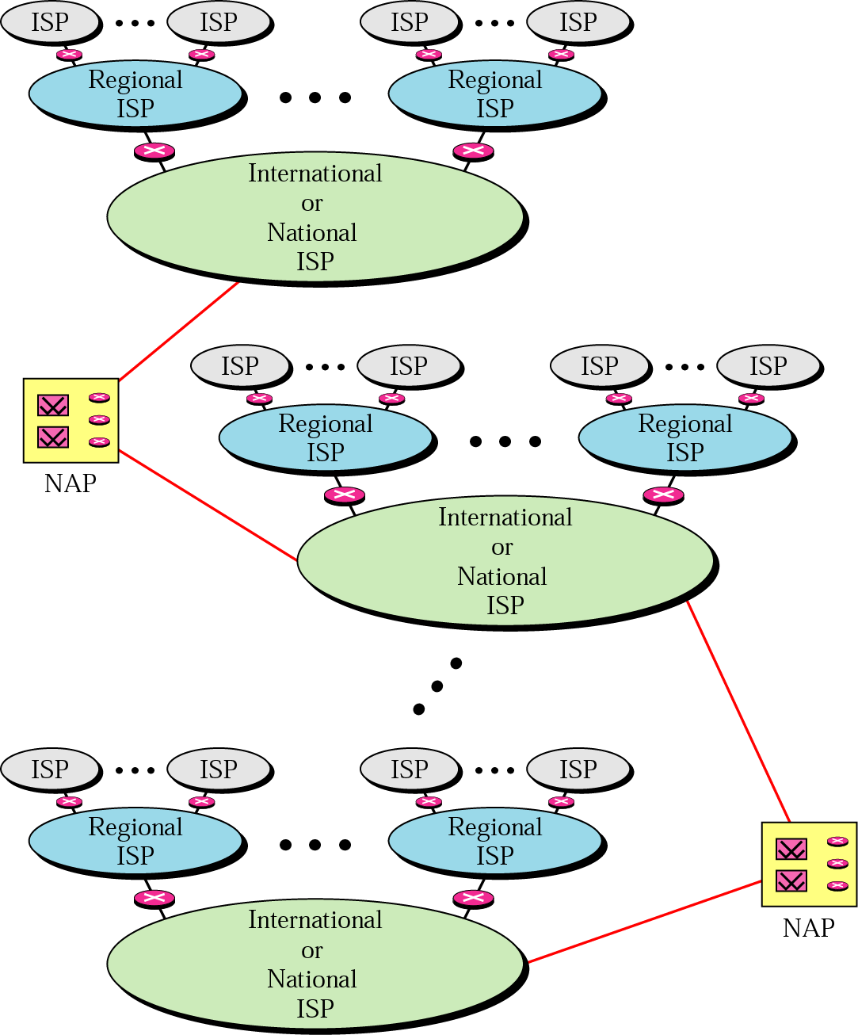
The Internet connection using ISP
NAP: Network Access Point

Slide 12
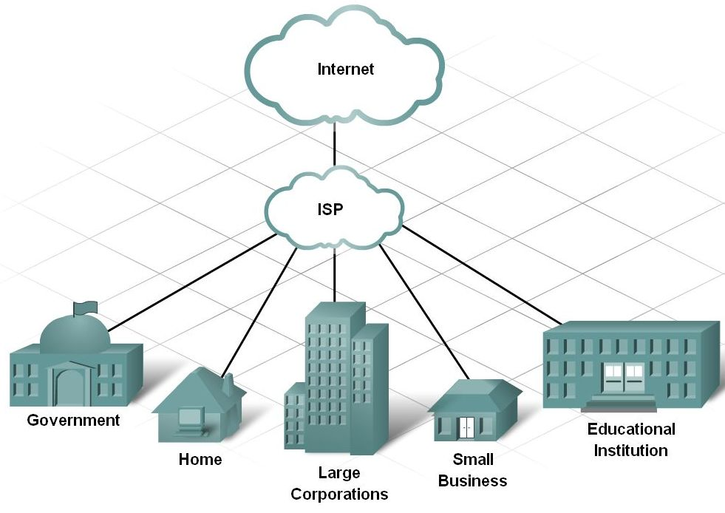
The Internet connection using ISP
Define an Internet Service Provider and its purpose

Slide 13
PoP (a point-of-presence)
On the Internet, a point-of-presence (PoP) is an access point from one place to the rest of the Internet. (POP also stands for the e-mail Post Office Protocol; see POP3.)
A POP is the connection point between the ISP's network and the particular geographical region that the POP is servicing.
An ISP may have many POPs depending on its size and the area it services
The Internet is made up of very high-speed data links that interconnect ISP POPs and ISPs to each other.
These interconnections are part of the very large, high capacity network known as the Internet Backbone.

Slide 14
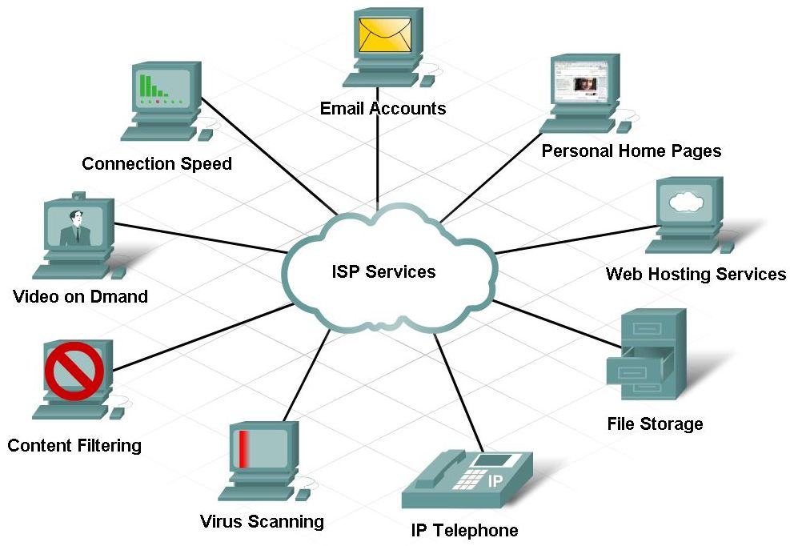
The Internet with ISP
The contract with the ISP determines the type and level of services that are available.

Slide 15
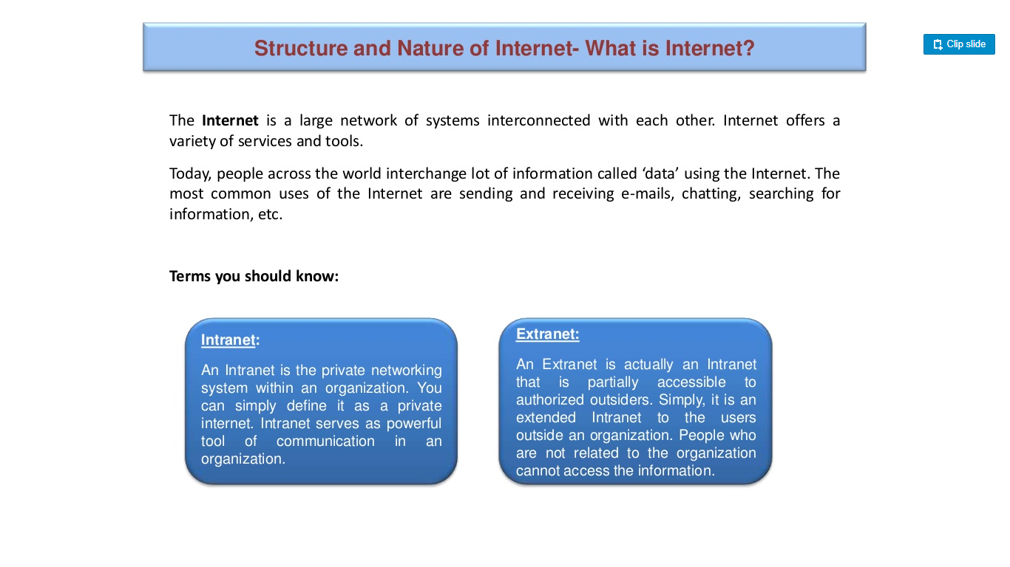
Internet, Intranet & Extranet

Slide 16
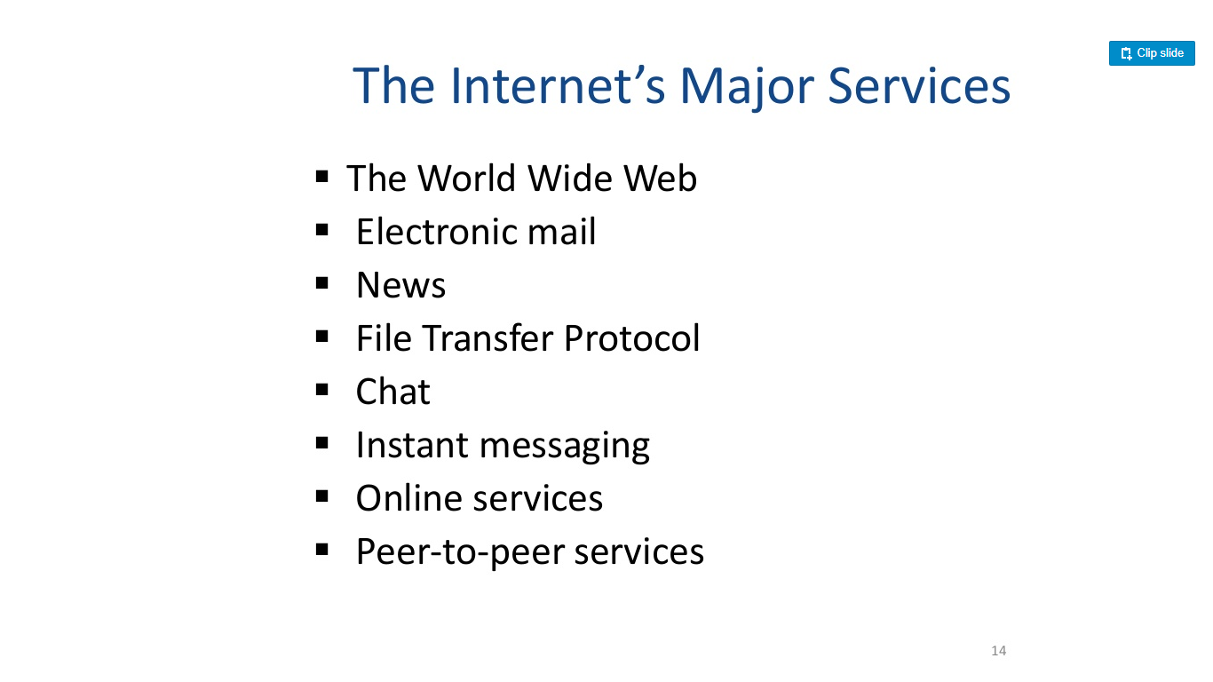
Major services of Internet

Slide 17
Connection Types
Dial-Up Connection
Use a modem to access the Internet on a per-use basis. The user accesses the ISP via phone line and when finished, disconnects from the ISP.
The speed of access is determined by the speed of your modem.
To gain faster access, you can install an Integrated Services Digital Network (ISDN) line, which is a digital phone line.
Direct Connection
Provide continuous access to the Internet
Convenient and fast and capable of handling high bandwidth

Slide 18
Domain Name System (DNS)
To access a website, you must enter the address of the web server in your browser.
The IP address (the dotted quad) is one way to identify the server; however, most users prefer to use domain names because they are easier to remember.
The Domain Name System (DNS) translates IP addresses into easily recognizable names.
Examples: IP address: 72.64.56.86
Domain name: www.microsoft.com

Slide 19
Domain Names
Each domain name is unique. It consists of letters and numbers separated by dots and includes two or more words (labels).
The last label in a domain name is usually a two- or three-letter code called a top-level domain.
Example: www.microsoft.com
Server (Host) Name Registered Company Domain Category
Domain Name (Top-Level Domain)

Slide 20
Domain Name Syntax
A domain name, read left to right, specifies general divisions, then specific companies, and individual computers (web servers or e-mail servers)
com = a commercial site
microsoft = the name registered by the company
www = the name of the web server at the company, also called the web site host

Slide 21
Domain Names
A fully qualified domain name (FQDN) is the complete domain name of an Internet computer. It provides enough information to covert the domain name to an IP address.
Top-Level Domains
.com = commercial or company sites
.edu = educational institutions
.gov = government
.org = organizations
.net = network sites, including commercial ISPs
.int = international organizations
Two-Letter Country Codes – categorize domains by country or region. For example: us = United States
au = Australia

Slide 22
Registering a Domain Name
Network Solutions (www.networksolutions.com) was selected as one of the original five registrars.
Registrars provide the following services:
Domain name registration
Registration service forms for domain name transfers, modifications, etc.
Resource links for payment options and policies.
Search capabilities for registered domain names, host IP addresses, and last name/first name queries using WHOIS (an internet utility primarily used to query databases to determine registered hosts)

Slide 23
Uniform Resource Locators (URL)
A URL is a text string that supplies an internet or intranet address and the method by which the address can be accessed.
URLs start with the http:// prefix which identifies them as web pages using the Hypertext Transfer Protocol.
For example, if you enter the following web address:
http://www.microsoft.com
The URL will access a web page because it begins with http. It then contacts the web server and domain named www.icann.org. It will locate a file on the server.

Slide 24
Uniform Resource Locator (URL)
http://www.prenhall.com/reed/index.html
Web Server
Name of the page
Or document
Protocol
(means of access)
Directory where the
Page is stored

Slide 25
URL
Top-level domains include “edu,” “gov,” and “org,” but “com” is most common
Examples:
www.microsoft.com
www.nba.com
www.whitehouse.gov
www.miami.edu

Slide 26
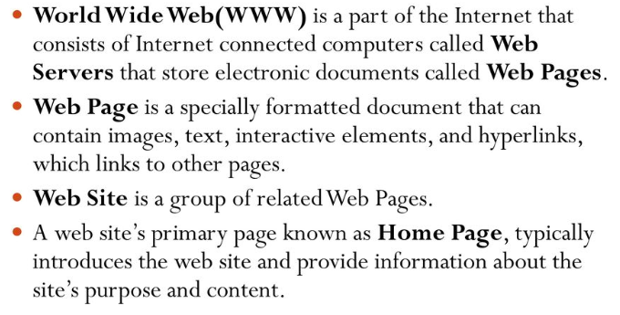
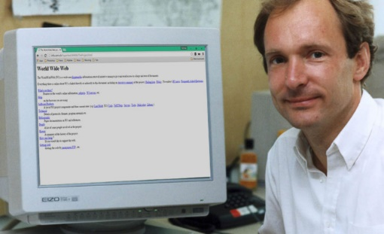
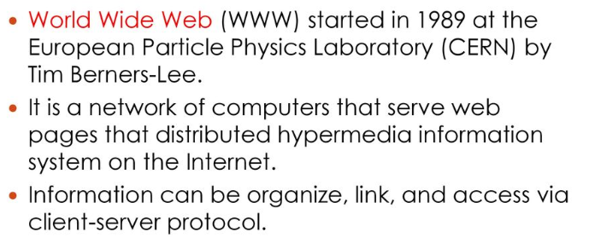
World Wide Web (WWW)
http://info.cern.ch/hypertext/WWW/TheProject.html

Slide 27
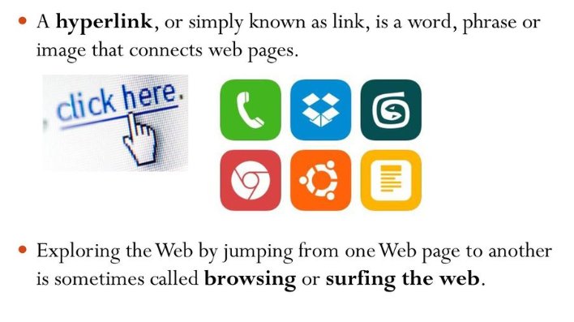
World Wide Web (WWW)

Slide 28
Web Server
Web server is a program that generates and transmits responses to client requests for web resources. It has several key steps as follows:
Parsing the request message
Checking that request is authorized
Associating the URL in the request with file name
Constructing the response message
Transmitting the response message to requesting client
Most popular web server software are
Apache for Linux,
IIS for Windows.
They are responsible for establishing connection between client and server controlling user access, managing files, and dispatching documents to clients.

Slide 29
Match the following
1 | internet | a) Hypertext Preprocessor | 5
2 | extranet | b) communication inside group | 3
3 | intranet | c) network of network | 1
4 | client side validation | d) secured communication between group | 2
5 | server side validation | e) define the structure of web pages | 6
6 | derived from SGML | f) it is a programming language
7 | Java script | g) scripting language | 7
8 | DNS | h) CSS | 11
9 | URL | i) translates IP addresses into easily recognizable names | 8
10 | Web Server | j) a text string that supplies an internet address | 9
11 | providing additional effects to tag | k) Unified Resource Location
12 | Web Browser | l) Transmitting the response message to requesting client | 10
 |  | m) check: password field is blank | 4
 |  | n) allows user to access web resources | 12

Slide 30
Web Site versus Web Server
A Website consists of a collection of web pages associated with a particular hostname.
A Web server is a program satisfy client requests for Web resources.

Slide 31
Web Browsers
Web browsers – allows users to access web resources
Internet explorer
Firefox
Opera
Safari
Google Chrome
A plug-in is a program that extends the capability of a web browser
Acrobat Reader, Flash Player, Java, Quick Time, Realplayer, Windows Media Player

Slide 32
Domain name Vs URL
The main motive of the domain name is to make it easier to access a website. They are more used as a brand and are usually referred to as a brand name. | If you want to find a particular website, URL is best for it, because a URL is a complete web address to find a particular website.
A domain name is a human-friendly text form of the IP address. | URL is a string that represents the complete web address of any web page.
It is the part of the URL that is more human friendly. | It is the string that represents a complete web address that contains the domain name.
It contains three parts Top Level Domain, Intermediate Level, and the Low Level. | It also contains the following parts’ method, protocol, hostname, port, and path of the file
Example: sastra.edu | Example: https://www.sastra.edu/academics/schools.html

Slide 33
Web Browser and Network
Network
Browser
request
Web site
reply
OS
Hardware
Browser sends requests
Web site sends response pages, which may include code
Interaction susceptible to network attacks

Slide 34
Languages
HTML
To create web documents or pages that can be rendered on web browsers
CSS
To create styles for developing appealing web sites with consistent looks across pages
JavaScript
To develop dynamic pages which interact with users, have some programming capability
Server-side languages
To build customized web pages based on users requests on the fly

Slide 35
Tools
Editors
Domain registration
Web hosting
FTP Software
MAMP server

Slide 36
Editors
Brackets
Net beans
Komodo
Dreamweaver
Sublime Text
VS Code

Slide 37
Domain Name Registration
Registry
the name space’s database
the organization which has edit control of that database
Including dispute resolution, policy control, etc.
The organization which runs the authoritative name servers for that name space
Registrar
the agent which submits change requests to the registry on behalf of the registrant
Registrant
The entity which makes use of the domain name

Slide 38
Registries, Registrars, and Registrants
Registry updates
zone
Master
updated
Registry
Zone DB
Registrar submits
add/modify/delete
to registry
Slaves
updated
Registrar
Registrar
Registrar
End user requests
add/modify/delete
Registrants

Slide 39
Web hosting
Web hosting allows anybody to rent a server configured to run web sites.
Different types of web hosting available
Shared hosting
Dedicated hosting
Cloud hosting

Slide 40
Media Types
Modern web sites contain different types of media
Images, text, audio, video, animation files etc.
This is called multimedia

Slide 41
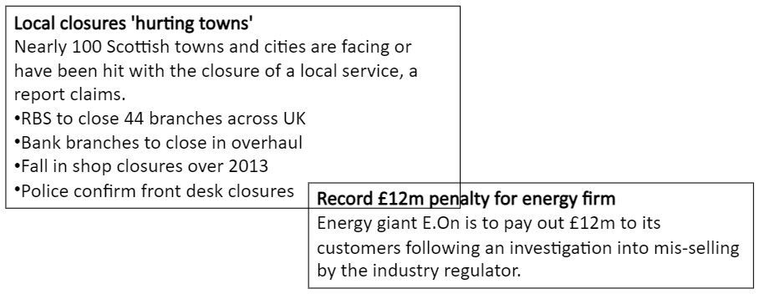
Multimedia type - Text
Virtually all websites contain text in the form of paragraphs, sentences, words and characters

Slide 42
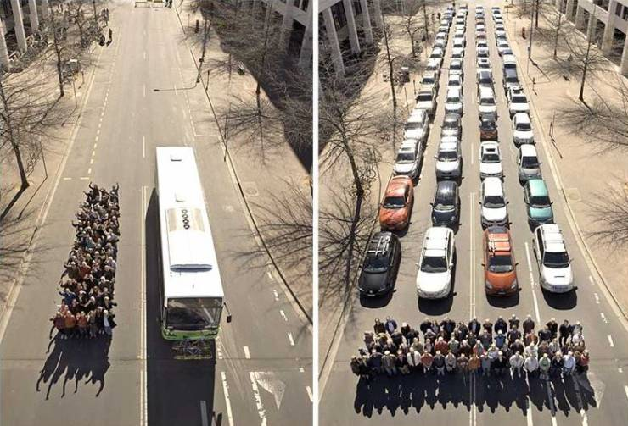
Multimedia type- Graphics
Graphics including photographs, drawings, logos are often used for information and/or to help with understanding.
“A picture tells a thousand words”

Slide 43
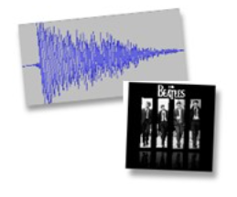

Multimedia type- Sound & Video
Sounds can be used to improve a user’s experience of the website.
Videos can also be used to improve a user’s experience of the website

Slide 44
Hyperlinks
A hyperlink is a point on a page that when clicked will take user to a different location.
Using hyperlinks pages on a web site gets linked together and users can navigate to pages within a web site.
Using hyperlinks different web sites too can be linked.

Slide 45
Internet Protocols
There are various types of protocols that support a major role in communicating with different devices across the network.
Transmission Control Protocol (TCP)
Internet Protocol (IP)
User Datagram Protocol (UDP)
Post office Protocol (POP)
Simple mail transport Protocol (SMTP)
File Transfer Protocol (FTP)
Hyper Text Transfer Protocol (HTTP)
Hyper Text Transfer Protocol Secure (HTTPS)
Telnet
Gopher

Slide 46
Web Standards
Web standards are blueprints / building blocks of a consistent and harmonious digitally connected world.
They are implemented in
browsers, blogs, search engines, and other software that power our experience on the web
Why W3C web standards?
to maximize consensus, ensure quality, interoperability, security, privacy, web accessibility, and internationalization.
W3C's proven web standards process to make the web work, for everyone. https://www.w3.org/standards/

Slide 47
Categories of Web Applications
Static
Serve fixed content
Content doesn’t change based on user interaction
Simple HTML and CSS
Examples: Personal blogs, portfolio websites
Dynamic
Content changes based on user interaction
Use server-side scripting languages (e.g., PHP, ASP.NET)
Interactive and functional
Examples: Social media platforms, e-commerce sites

Slide 48
Categories of Web Applications
E-commerce Web Applications
Enable online transactions
Integrate payment gateways
Manage inventory and customer data
Examples: Amazon, eBay
Portal Web Applications
Provide a gateway to various services
Aggregate content from different sources
Customizable user interfaces
Examples: Yahoo, MSN

Slide 49
Categories of Web Applications
Content Management Systems (CMS)
Allow creation and management of digital content
User-friendly interfaces
Examples: WordPress, Joomla
Progressive Web Applications (PWA)
Combine features of native apps and web apps
Work offline and load quickly
Examples: Twitter Lite, Pinterest

Slide 50
Categories of Web Applications
Single Page Applications (SPA)
Load a single HTML page
Update content dynamically without reloading
Use JavaScript frameworks (e.g., React, Angular)
Examples: Gmail, Google Maps

Slide 51
Characteristics of Web Applications
Following are few of the characteristics which the web application should have:
Availability.
Performance. ...
Scalability. ...
Security. ...
Ease of use.

Slide 52
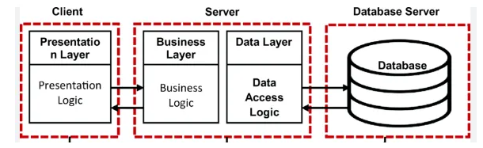
Tiered Architecture
Single Tiered - the entire application runs on a single machine or server.
Two Tiered - the application is divided into two main tiers: client and server.
Three Tiered - adds an additional layer between the client and server tiers, known as the middle or
application tier.

Slide 53
Useful Resources
https://www.w3schools.com/
https://www.w3schools.in/category/html-tutorial/

